Slide 1
Cloud Computing Project Presentation
Group 7 - Ting Han Ko, Xiangxu Li, Yilin Yang
5450 Cloud Computing

Slide 2

Business Case
A new liquor business is interested in entering the liquor market in Iowa state and would like to better understand the market. Some insights that can be helpful to the business:
Sales of different types of liquor in different regions and stores
Seasonality of the liquor sales

Slide 3
Data Source and Procurement
Data
Iowa Liquor Sales (csv file resized from 4.77 GB to 1.2 GB) This dataset contains the spirits purchase information of Iowa Class E liquor licensees by product and date of purchase from year 2012 to 2022. Class E liquor is unopened liquor containers typically sold in grocery, liquor, and convenience stores.
Procurement
Data will be extracted from the open data website, and it was uploaded to the our S3 bucket through Amazon S3 console.
Notes:
A csv file originally 4.77 GB, resized to 1.2 GB for performance and efficiency purposes. it contains sales record in grocery store, liquor store, and convenience store.

Slide 4
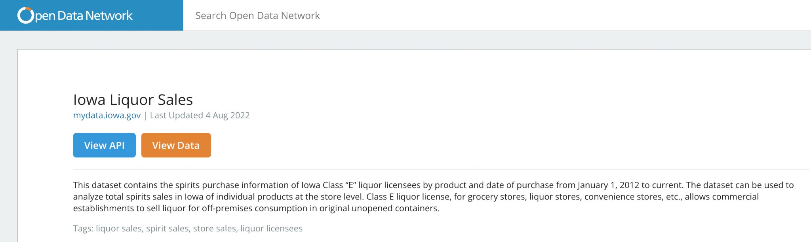
Data Source and Procurement
Source
https://www.opendatanetwork.com/dataset/mydata.iowa.gov/m3tr-qhgy
Notes:
source from government

Slide 5
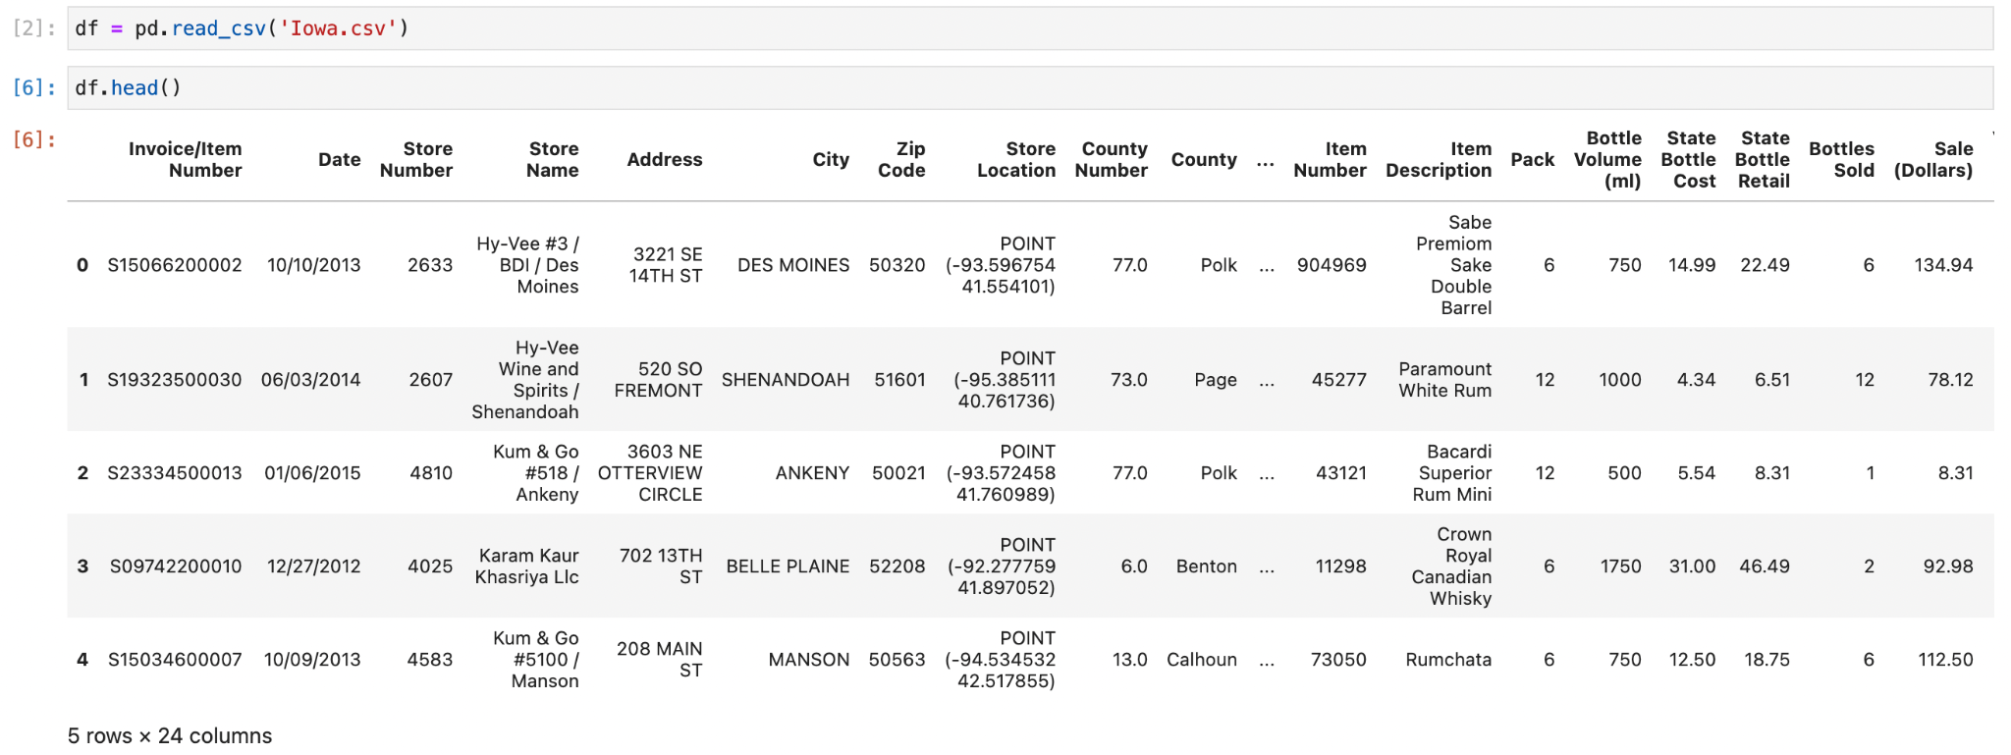
Data Quick Overview- Iowa Liquor Sales

Slide 6
Areas of Responsibility
Yilin Yang VPC Setup, dataset procurement and management in S3, and CloudWatch setup
Ting Han Ko Amazon EC2 setup, Security setup (IAM, security group etc.), and Amazon RDS configuration, loading, and querying
Xiangxu Li Flask server setup for queries to present analytic results and Amazon Sagemaker set up, Cost analysis in AWS Pricing Calculator
Notes:
Yilin is in charge of first stage VPC, S3, CloudWatch
I worked on EC2, Security, RDS
Xiangxu takes care of our final stage with Flask, SageMaker, Cost analysis.

Slide 7





Cloud Architecture
VPC
Amazon VPC: provides network security and network configuration options
Amazon S3 as our scalable and reliable data storage infrastructure to store data
Amazon EC2 as our compute and server platform
Hold the data from S3 and loads it into Amazon RDS
Runs flask server to display query results (Flask was be built on Python to present analysis result)
Amazon RDS: manages processed structured data (Amazon Redshift will be a future extension since it is not available in Learner Lab)
Amazon Sagemaker for machine learning and analysis
S3
EC2
RDS
Sagemaker

Slide 8
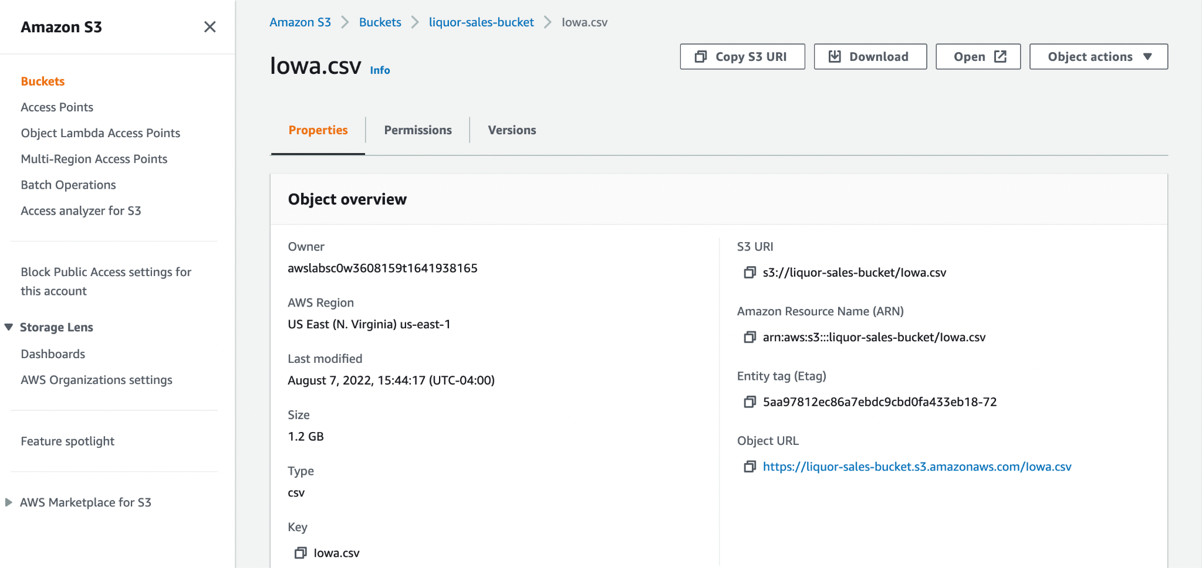
Cloud Architecture- Data in S3
Notes:
Here is our demonstration jumping directly to S3 setup

Slide 9
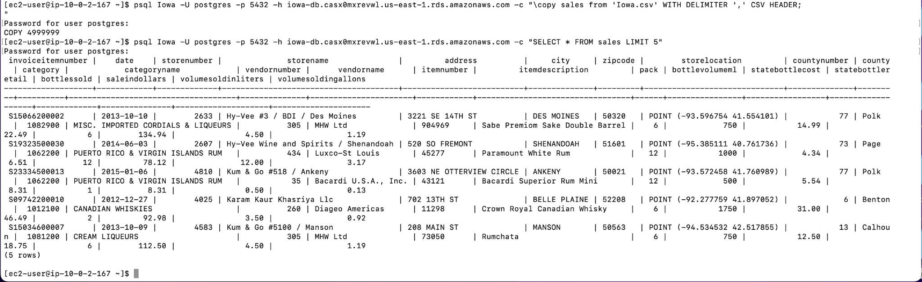
Cloud Architecture- ETL Process
From S3 to EC2 to RDS DB

Slide 10
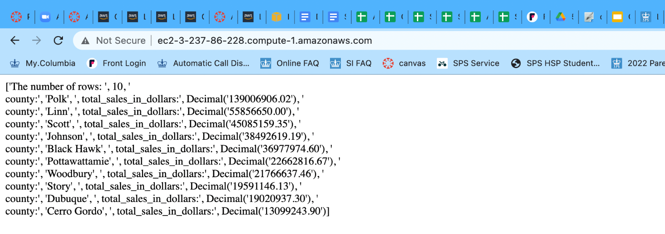
Cloud Architecture- Flask result
Top 10 sales records grouped by counties showing on flask server

Slide 11
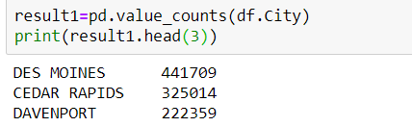
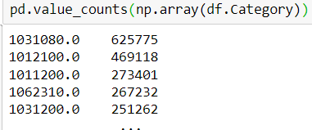
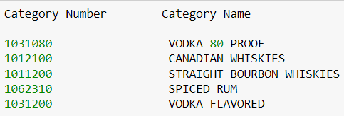
Cloud Architecture- SageMaker result
Top 3 cities in terms of sales
Top categories in term of sales

Slide 12







Cloud Architecture- Other Services
Other services are recommended to complete the security, reliability, availability, scalability, performance, and cost-optimization. However, FIS, Cost Explorer, KMS, Redshift, Backup are not implemented in this project example.
IAM
Manage access to AWS resources
FIS
Improve resiliency and performance with controlled experiments.
AWS Backup
Automate backup processes
Amazon Redshift
Manages data for reporting and analytics purposes
KMS
Create and manage cryptographic keys
Cost Explorer
Visualize and explore the cost
Cloudwatch
Monitor resources and application

Slide 13
Cloud Architecture Design Principles
Security
Reliability + Availability + Scalability
Performance
Cost-optimization

Slide 14
Cloud Architecture - Security
Technologies Implemented:
VPC
The use of SSH key when connecting to AWS CLI
Configure an AWS Identity and Access Management (IAM) role
Future Extensions:
AWS encryption solutions and default security controls
Multi-factor authentication (MFA)
IAM - manage authentications and permissions
AWS Key Management Service (KMS) - create and manage cryptographic keys
Amazon Cloudtrail - detect and investigate security events

Slide 15
Cloud Architecture - Reliability + Availability + Scalability
Technologies Implemented:
Multiple Availability Zones for reliability
Amazon Cloudwatch to adapt to changes in demand for scalability
Amazon S3 (99.99% availability and an average annual expected loss of 0.000000001% of objects) and Amazon EC2 (offers 99.9% availability for each Amazon EC2 region)
Future Extensions:
AWS Auto Scaling to withstand component failures
AWS Backup for recoverability
AWS Fault Injection Simulator (FIS) to run fault injection experiments and test reliability
Point-in-time recovery (PITR) in AWS RDS and Runbooks to plan for disaster recovery
Playbooks for disruptive changes
Amazon Redshift - add notes more larger storage capacity
Notes:
Playbook
Enable consistent and prompt responses to failure scenarios by documenting the investigation process in playbooks. Playbooks are the predefined steps to perform to identify an issue. The results from any process step are used to determine the next steps to take until the issue is identified or escalated.
For example, you could define a playbook for network connectivity issues to an application. The initial step might be to determine if the client is able to resolve DNS for the site. The second step might be to determine if the client can reach the host of the site. If the client is able to reach the host, the next step might be to investigate the application web service. If the client is not able to reach the site, the next step might be to determine the path the client takes to the site. Each step should help isolate the source of the issue so that ultimately it can be identified and then addressed
A playbook is a unique overarching set of guides that an organization has prepared and compiled for its teams. In contrast, a runbook is a specific outline for helping with a task, bridging the differences in staff skill sets.
Three factors that influence the availability of your applications are fault tolerance, scalability, and recoverability

Slide 16
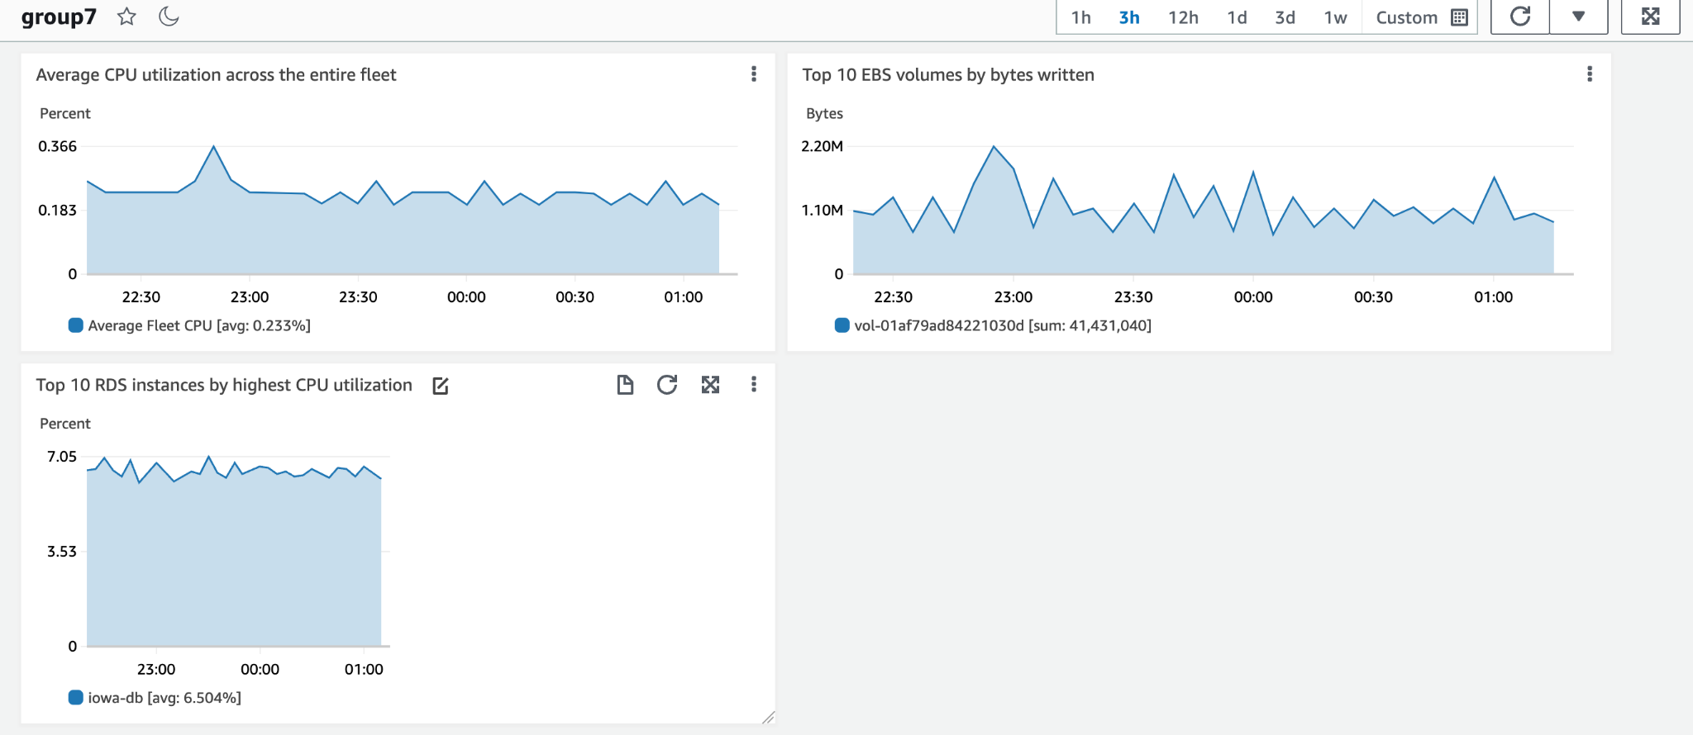
Cloud Architecture - Performance
Technologies Implemented:
Amazon CloudWatch

Slide 17
Cloud Architecture - Performance (continued)
Technologies Implemented:
Amazon S3 - economical and efficient, the tradeoff is that the data has to be read into RDS to transform the data
Amazon EC2 - offers complete control over the AWS compute resources and infrastructure
Amazon RDS - helps to set up, operate, and scale a relational database which works for this particular business’s needs
Amazon SageMaker - accelerate and streamline the machine learning lifecycle
Future Extensions:
Network solution configurations

Slide 18
Cloud Architecture - Cost-optimization
Technologies Implemented:
AWS pricing calculator
Future Extensions:
AWS Cost Explorer - estimate resource utilization and spend, explore cost optimization opportunities, and also to forecast costs
AWS Budgets - control cost and usage with alerts, and configure actions that automatically respond to avoid overspending
Review the existing architectural decisions to optimize over time
S3 archiving system

Slide 19
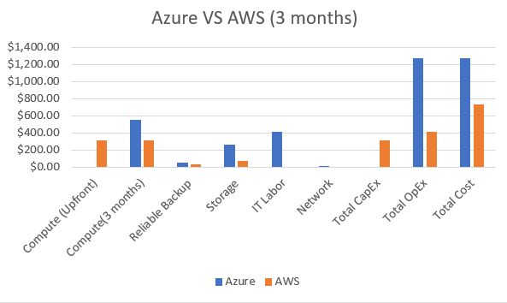
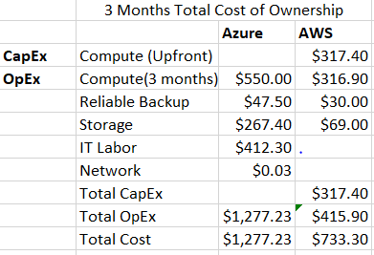
Economics of Cloud Computing / Cost Analysis
AWS and Microsoft Azure 3 Months Total Cost Of Ownership (TCO) Comparison
Notes:
According to our business case, the business analysis project could be done in 3 months. If our client wants to keep the cloud computing for future exploration, we can extend the term to 1 year.
For 3 months period, AWS could save us 42% and the total saving is $543
For 1 year, we could join the EC2 1-Year Instance Savings Plans to save more.
AWS’s total cost of ownership (TCO) is lower than Azure and it saves us 51% a year and the 1-year total saving is $2,441.
AWS also comes with free cloud services such as Amazon VPC, Auto Scaling, IAM, AWS Cost and Usage report and some other services are also included in the AWS free tier such as Amazon Cloud Watch and AWS KMS.
Therefore, we decided to go with AWS cloud provider with 1TB S3 Standard Storage, and All Upfront Payment for the following specifications: vCPUs: 4, Memory: 16GB, Storage: 1TB, and General Purpose SSD.

Slide 20
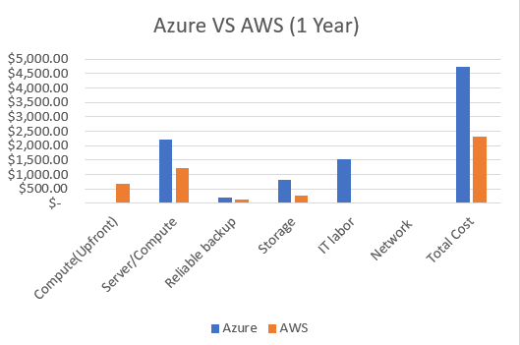
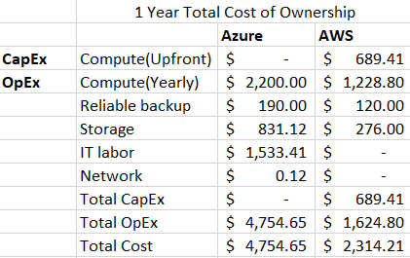
Economics of Cloud Computing / Cost Analysis
AWS and Microsoft Azure 1-Year TCO Comparison

Slide 21
Economics of Cloud Computing / Cost Analysis
AWS TCO is lower than Azure: it saves us $543 (42%) for 3 months and $2,441 (51%) a year.
Cloud configurations:
1TB S3 Standard Storage
EC2 1-Year Instance Savings Plans
All Upfront Payment with the following specifications: vCPUs: 4, Memory: 16GB, Storage: 1TB, and General Purpose SSD.
Free tier services available: Amazon VPC, Auto Scaling, IAM, AWS Cost and Usage reports, Amazon Cloud Watch and AWS KMS.

Slide 22
Success Criteria
Set up VPC
Set up security groups
Load data into an S3 bucket
Data processed and flask running in EC2
Modify a role in IAM to allow EC2 and RDS to access S3
RDS configured and loaded with processed data
Activate flask server that query data and display analytic results
Set up Cloudwatch to monitor CPU utilization and send alarms if CPU utilization is high
Set up a notebook instance in Sagemaker to analyze data

Slide 23
Q&A
Thank You!
Group 7- Yilin Yang, Xiangxu Li, Ting Han Ko

Slide 24
References
Marquez, E. (2022, February 3). When to use Amazon Rds vs. redshift. SearchCloudComputing. Retrieved July 23, 2022, from https://www.techtarget.com/searchcloudcomputing/tip/When-to-use-Amazon-RDS-vs-Redshift Ned HallettPublished on September 2020 Published on September 2020, 2020, N. H. P. on S., Hallett, N., &amp; 2020, P. on S. (n.d.). EBS vs EFS vs S3 – when to use AWS' three storage solutions. Just After Midnight. Retrieved July 23, 2022, from https://www.justaftermidnight247.com/insights/ebs-efs-and-s3-when-to-use-awss-three-storage-solutions/
Colegio Oficial de Médicos de la Provincia, Valladolid. (2016). VPC: Validación Periódica de La Colegiación. Amazon. Retrieved July 23, 2022, from https://docs.aws.amazon.com/vpc/latest/userguide/what-is-amazon-vpc.html
Bellasio, S. (2019, July 11). Amazon VPC: 5 reasons to use and learn it...with Cloud Academy! Cloud Academy. Retrieved July 23, 2022, from https://cloudacademy.com/blog/how-and-why-to-use-vpc-for-your-amazon-aws-infrastructure/

Slide 25
References
Explain the Amazon sagemaker and advantages of SageMaker -. ProjectPro. (n.d.). Retrieved July 23, 2022, from https://www.projectpro.io/recipes/explain-amazon-sagemaker-and-advantages-of-sagemaker
Amazon (AWS) EC2 instance: Benefits &amp; how it works? Cloud Infrastructure Services and Enterprise grade Network &amp; IT Solutions Provider. (2021, May 31). Retrieved July 23, 2022, from https://www.sndkcorp.com/amazon-ec2/
Free Cloud Computing Services - AWS Free Tier. (2022). Amazon Web Services, Inc. Retrieved July 23, 2022, from https://aws.amazon.com/free/?all-free-tier.sort-by=item.additionalFields.SortRank&all-free-tier.sort-order=asc&awsf.Free%20Tier%20Types=*all&awsf.Free%20Tier%20Categories=*all
Total Cost of Ownership (TCO) Calculator. (2022). Microsoft Azure. Retrieved July 23, 2022, from https://azure.microsoft.com/en-us/pricing/tco/calculator/

